Slide 1
Cross-Platform Browser Instrumentation
CSE 608 - Fall 2013 Amogh Akshintala Vinay Krishnamurthy

Slide 2
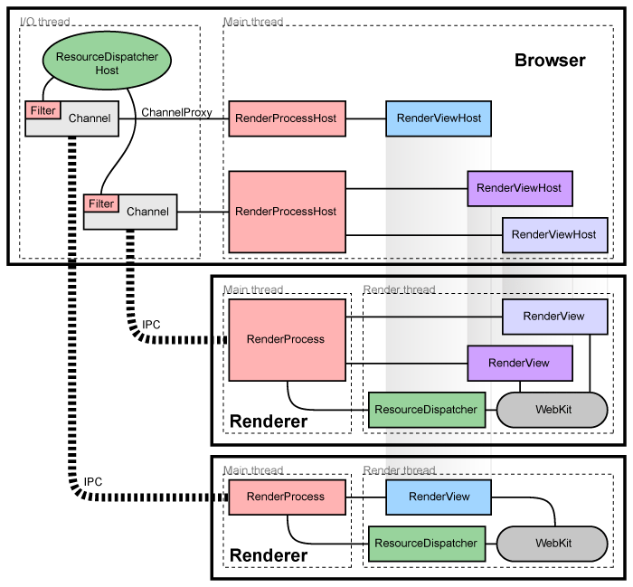
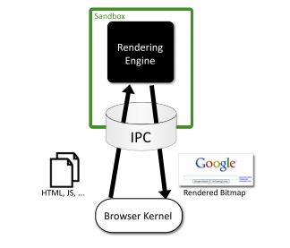
Chromium Browser - Overview
Architecture:
The browser is one process
Every new page load spawns a new renderer process
They communicate via IPC
This sandboxing ensures isolation
1
2

Slide 3
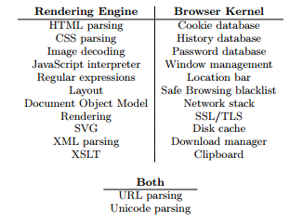
Chromium Browser - Division of Labor
Rendering Engine handles rendering alone
Doesn’t have access to any OS controlled resources
e.g. disk, network
Must use IPC to ask kernel
to fetch any resources over the network
to write to disk
1

Slide 4
Instrumentation - Overview
Targets: Android, Linux
Accepted Input: Text file with list of URLs to be crawled (optional).
For each crawling session, the following is recorded to a database:
HTML (per page/frame), cookies (per domain), scripts (per source)
DOM events: common W3C events and touch events
Web navigation events: before_URL_load, redirection, failures, file download, etc.
Screenshot

Slide 5
Instrumentation - Architecture
Chromium Browser Kernel
IPC
Webkit (Rendering Engine)
InstrumenterMessageFilter
Renderer Instrumenter
IPC
IPC
Webkit (Rendering Engine)
Instrumenter
InstrumenterDatabase
Renderer Instrumenter
DB

Slide 6
Database Schema
Table per process
Table name = “Browser/Renderer” + PID
4 columns
ID
Time stamp
Component raising the event, called Tag
Message

Slide 7
Logs on persistent storage
DB name - InstrumentedEvents.db
Raw data (ex: Script contents): All files under a new folder under File Contents folder
File name for raw data: UNIX Timestamp
Stored under:
Android: /sdcard/
Linux: /tmp/

Slide 8
Demo

Slide 9
What’s pending?
Automation
Screenshots
HTML raw content - cannot write to file, can log in logcat
Couple of event handlers specific to desktop Chrome (keyboard, mouse)

Slide 10
References
The Security Architecture of the Chromium Browser, Adam Barth et. al.
Multi Process Architecture of Chromium - http://dev.chromium.org/developers/design-documents/multi-process-architecture
DOM Events, Wikipedia http://en.wikipedia.org/wiki/DOM_events

